Slide 1
Student Extracurricular Management

Slide 2
Team Members
01
👤Karthik Chimata
👤Mani Pranavi Chendika
02
03
👤Tummala Nischala

Slide 3

INTRODUCTION
Extracurricular activity platform is a vibrant community of students passionate about exploring interests beyond academics. Our club provides a platform for members to discover new talents, develop skills, and build lifelong connections. Join us to unleash your creativity, challenge yourself, and make unforgettable memories.
Explore. Engage. Excel.

Slide 4
Benefits of Student Extracurricular Management
Centralized Information
All student participation data (such as registered events, feedback, and credentials) is stored in one place. This allows administrators to quickly access information about any student's past and upcoming activities, ensuring a streamlined approach to managing student involvement.
Automated ProcesseS
Students can receive automated reminders for upcoming events they've registered for.
- Feedback requests are automatically sent after event completion, streamlining the process and saving time for administrators.

Slide 5
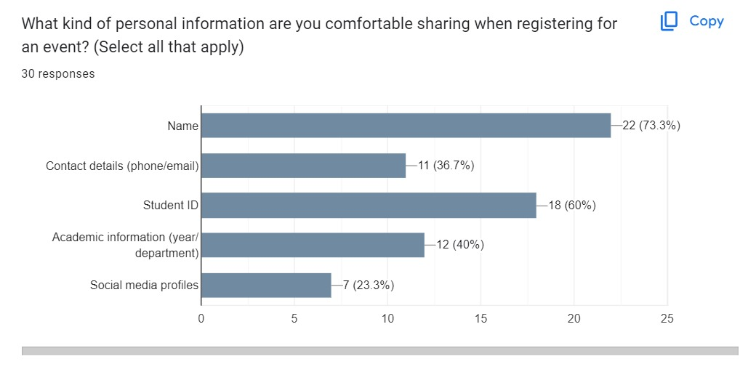
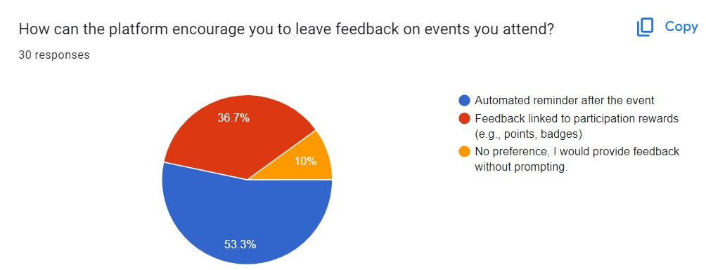
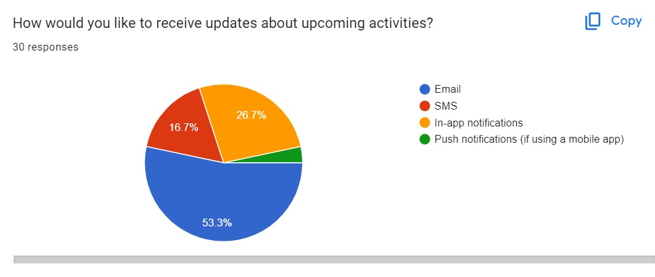
🎯 Survey Form
We conducted a survey to understand how students currently manage their extracurricular activities and identified gaps in organization, scheduling, and communication.

Slide 6

🎯 Project Concept & Research
Our idea originated from the need for a centralized platform where students can easily organize and participate in extracurricular events. We conducted researche among students who use extracurricular activity platforms and noted the common challenges such as poor communication, lack of reminders, and disorganized event management.
We used student reviews for management strategies to ensure that our platform would enhance participation while being simple to use.

Slide 7

🎯 Technologies to be Used
For this project, our tech stack includes:
Front-End:
CSS
JavaScript
Middleware:
Spring Boot
Database:
MySQL

Slide 8

🎯 Front-End Development
The user interface is designed with HTML, CSS, and JavaScript, utilizing Bootstrap for responsive layouts. The interface is clean and intuitive, aimed at minimizing confusion and making it easy for students to navigate through their event options. 🛠 Middleware (Business Logic Layer): The business logic is built using Spring Boot to handle backend operations, such as event creation, notifications, and tracking student participation. This layer ensures smooth operations and efficient handling of user inputs and event data. 💾 Database Connectivity: We used Spring Data JPA to manage the connection to our database, where information about events, student registrations, and activity logs are stored. This ensures efficient storage and retrieval of event data.

Slide 9

🎯Admin Modules
ADMIN LOGIN
ADMIN DASHBOARD
TRACK STUDENT PARTICIPATION GATHER FEEDBACK VIEW FEEDBACK
ADD EVENT
MANAGE EVENT UPDATE EVENT
MANAGE STUDENT CREDENTIALS

Slide 10

🎯User Modules
STUDENT LOGIN
STUDENT DASHBOARD
TRACK PARTICIPATION
REGISTER FOR EVENT
SUBMIT FEEDBACK

Slide 11

🎯 Testing & Feedback
Testing was a key focus for us, ensuring a smooth user experience for both students and organizers. ⏭ User Testing: Students have been testing the platform’s registration and notification systems, providing feedback on ease of use. ⏭ Admin Testing: Event organizers are ensuring that the platform meets their needs for event creation and management.

Slide 12
🎯 Conclusion
JFSD-PS27 has made significant progress, but we are still working on perfecting the system. Our platform aims to provide an efficient, user-friendly tool for organizing and managing student extracurricular activities. With its customizable event recommendations and smooth integration of scheduling features, we are confident that this tool will greatly enhance student engagement and participation.

